Slide 1
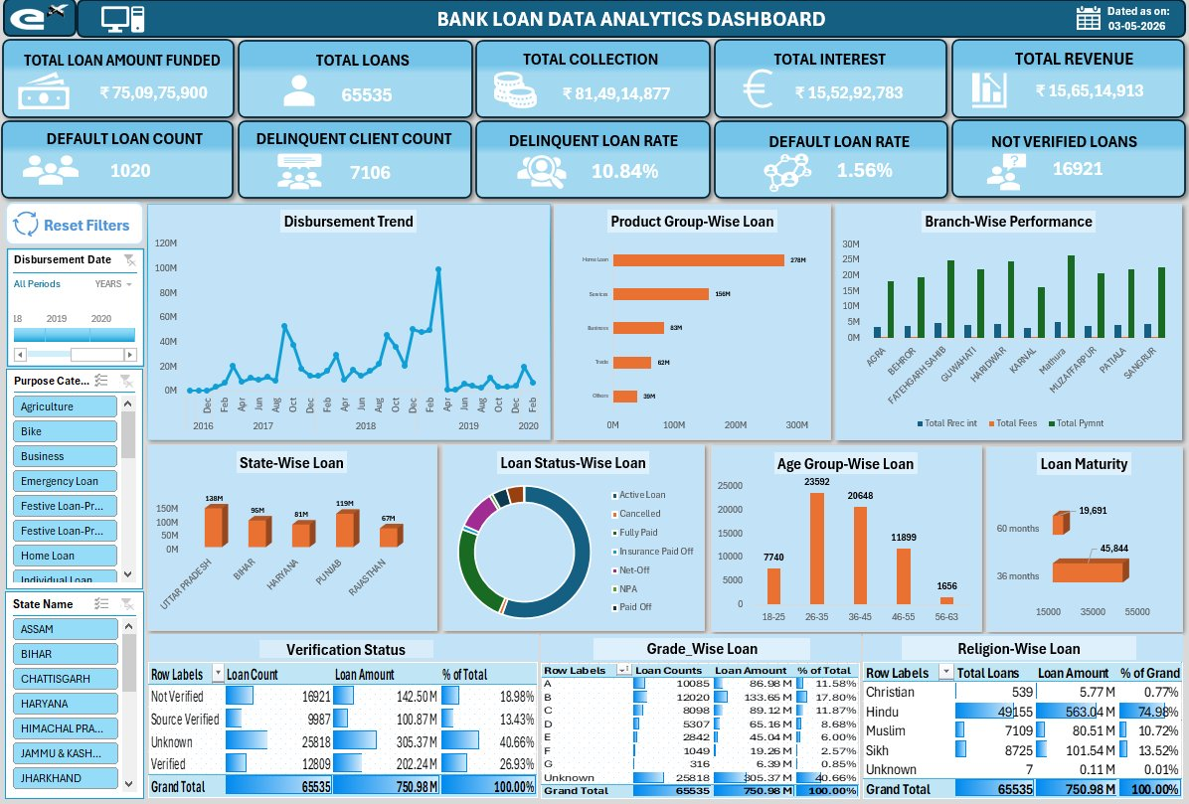
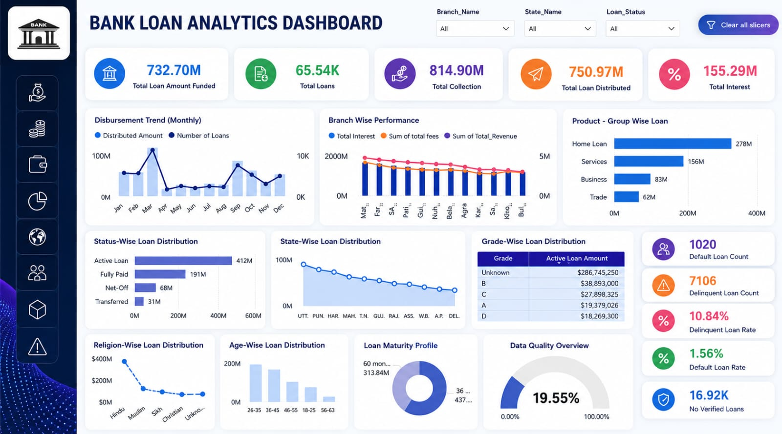
DATA ANALYTICS • BUSINESS INTELLIGENCE • SQL / EXCEL / TABLEAU / POWER BI
DASHBOARD PREVIEW
Bank Loan
Data Analytics
Multi-Tool Dashboard Analysis
A comprehensive data analytics project leveraging SQL, Excel, Tableau, and Power BI to analyse 65,535 loan records — uncovering disbursement patterns, default risks, and revenue drivers across branches and geographies.
65,535
₹750.98M
₹156.51M
1.56%
Total Loans
Funded Amount
Total Revenue
Default Rate

Slide 2
Project Overview
01
What this project is about and what tools were used
MySQL
Excel
Tableau
Power BI
Data extraction and KPI computation using structured queries across the loans database.
Interactive pivot-table dashboard with slicers for filtering by state, purpose & date.
Visual analytics with map-based, trend, and distribution charts for deep exploration.
Executive dashboard with real-time slicers, gradient visuals, and KPI scorecards.
65,535
18
2016–2020
4 Tools
Total Loan Records
States Covered
Time Period
Tech Stack

Slide 3
Excel Dashboard
02
Interactive pivot-table based analytics with slicers
KPI Metrics
Total funded ₹750.98M, 65,535 loans, 10.84% delinquency rate, 1.56% default rate, 16,921 unverified loans.
Disbursement Trend
Monthly line chart from 2016–2020; peak disbursements in early 2019 exceeding ₹100M.
Product-wise Loan
Home Loans dominate at ₹278M, followed by Services (₹156M) and Business (₹83M).
State & Branch View
Uttar Pradesh leads state-wise at ₹138M. Branch performance split by fees, interest, and payment.
Demographics
Age group 26–35 is the largest borrower segment. Religion-wise: Hindu borrowers 74.98% of total.

Slide 4
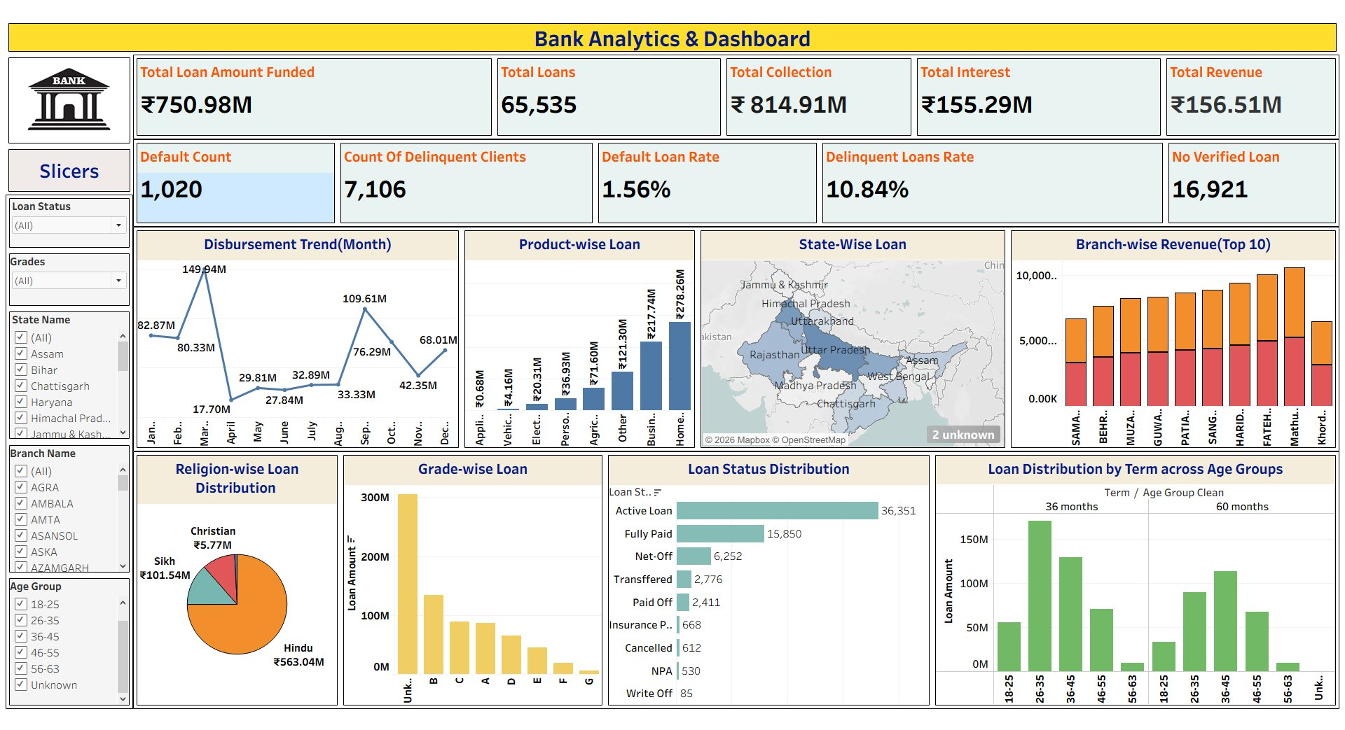
Tableau Dashboard
03
Visual analytics with maps, trends, and distribution charts
KPI Scorecard
₹750.98M funded, 65,535 total loans, ₹814.91M collected, ₹155.29M interest, ₹156.51M revenue.
Disbursement Trend
Monthly trend chart showing peak in February (₹149.94M), with dips mid-year — useful for seasonal planning.
State-Wise Map
Geographic heat map across India highlights UP, Bihar, Haryana, Punjab and Rajasthan as top lending states.
Grade-wise Analysis
Grade B dominates. Distribution reveals risk concentration in unrated (Unknown) loan segments.
Loan Status
36,351 Active loans, 15,850 Fully Paid. NPA count: 530. Write-offs: 85 — risk indicators at a glance.

Slide 5
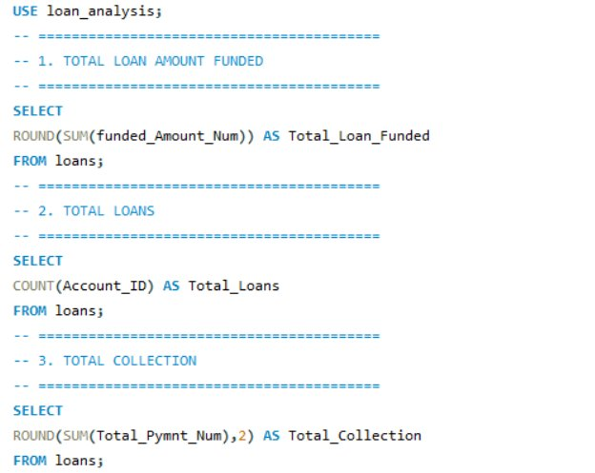
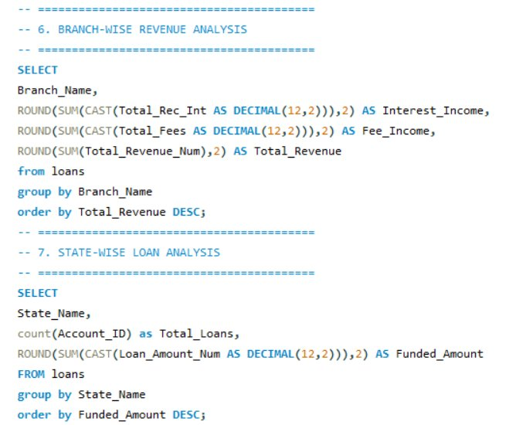
SQL — Data Extraction & KPI Computation
04
MySQL queries written to calculate all key metrics from the loan_analysis database
Queries 1–3: Loan KPIs
Queries 6–7: Branch & State Analysis

Slide 6
Power BI Dashboard
05
Executive-grade interactive dashboard with slicers and KPI cards
Top KPI Strip
732.70M funded, 65.54K loans, ₹814.90M collected, ₹750.97M distributed, ₹155.29M total interest.
Disbursement & Branch
Monthly dual-axis chart (amount + count) and branch performance revenue breakdown.
Product-wise Loans
Home Loans lead at ₹278M. Horizontal bar chart for quick product comparison.
Risk Indicators
1,020 defaults, 7,106 delinquent clients, 10.84% delinquency rate — all visible as KPI cards.
Demographic Breakdown
Religion-wise, age-wise, and loan maturity distribution — drill-down ready via slicers.

Slide 7
Key Business Insights
06
What the data reveals across all dashboards
01
Home Loans Dominate Portfolio
02
2019 Was Peak Disbursement Year
At ₹278M, home loans account for the largest loan product segment, nearly 2x the next category (Services ₹156M). Strategy should focus on home loan risk management.
Disbursements peaked dramatically in early 2019 (₹149.94M in a single month), followed by a sharp decline — suggesting a policy change or market event worth investigating.
03
Delinquency Is a Material Risk
04
Northern India Drives Volume
7,106 delinquent clients and a 10.84% delinquency rate indicate portfolio health concerns. 16,921 loans are unverified — a credit risk that needs immediate attention.
Uttar Pradesh (₹138M), Bihar (₹96M), and Haryana (₹81M) lead state-wise. Concentrating branch resources in these states would maximise ROI.
05
26–35 Age Group is Core Borrower
06
Grade B Dominates Loan Book
23,592 borrowers (largest segment) are aged 26–35, followed by 26–45 at 20,648. Products and credit scoring models should be calibrated for this demographic.
Grade B holds the largest active loan amount. Unknown/ungraded loans are a risk flag — improving loan grading coverage could improve portfolio quality scoring.

Slide 8
Conclusion & Next Steps
07
What we built • What we found • Where to go next
01
Multi-Tool Data Pipeline
Queried and aggregated 65,535 loan records in MySQL across 7 key metric dimensions. Exported clean datasets into Excel, Tableau, and Power BI for cross-platform validation.
02
Three Dashboards Built
Delivered Excel (pivot slicers), Tableau (geographic + trend), and Power BI (interactive KPI board) dashboards — each offering a different analytical lens on the same dataset.
03
Risk Findings Surfaced
10.84% delinquency rate and 16,921 unverified loans are key red flags. Recommended targeted verification campaigns and stricter credit scoring in high-delinquency segments.
04
Recommended Next Steps
Automate data refresh pipelines, implement predictive default models using ML, and integrate real-time branch data feeds for a live executive dashboard.

